Slide 1

CONSTITUTIONAL AMENDMENTS

Slide 2
PART I: THE EARLY ERA
Foundations of the 1973 Democratic Charter and the Bhutto Administration (1973–1977)

Slide 3


THE 1973 CONSTITUTION
A Democratic Charter
The Dynamics of Reform
The 1973 Constitution was framed by consensus as a federal parliamentary structure. It remains the supreme law of Pakistan, designed to balance federating units and establish citizen rights.
As a living document, its amendments document the push-and-pull between parliamentary supremacy and central executive power over five decades of political history.

Slide 4

CONSTITUTIONAL MILESTONES
26
Five Decades of Legislation
A total of twenty-six amendments have been formally enacted since 1973. This extensive history documents deep institutional evolutions, judicial restructuring, and the ongoing struggle for state power.
ENACTED AMENDMENTS

Slide 5

THE BHUTTO ERA (1973-1977)
Consolidating Power
Democratic Restructuring
Following the secession of East Pakistan, Prime Minister Zulfikar Ali Bhutto centralized civilian executive power, enacting the first seven amendments in quick succession.
This early phase focused heavily on defining post-war boundaries, addressing regional aspirations, managing internal dissent, and clarifying state religious definitions.

Slide 6
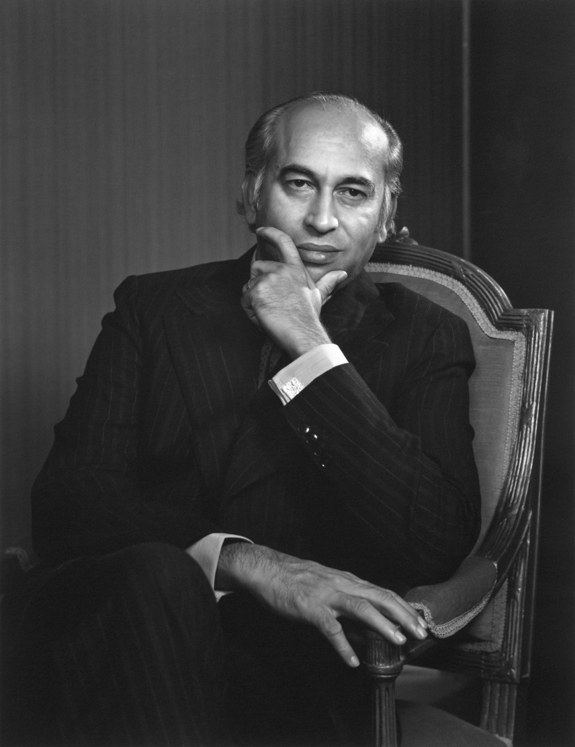
1ST AMENDMENT: NEW BORDERS
Redefining National Boundaries
Passed on May 4, 1974, the First Amendment formally accounted for the separation of East Pakistan following the 1971 war.
•
Removing References: Excised references to East Pakistan from the text of the Constitution.
•
Recognition of Bangladesh: Aligned the legal text with Pakistan's diplomatic recognition of Bangladesh at the OIC Summit.
•
Territorial Integrity: Formally defined the borders of the four remaining provinces.

Slide 7
2ND AMENDMENT: DEFINED MUSLIM
Historical Context: Enacted on September 17, 1974, during a period of massive political and social mobilization led by religious political parties.
Article 260(3) Insertion: Provided a formal, legal definition of who is considered a Muslim for constitutional and state purposes.
Ahmadi Status: Statutorily declared the Ahmadi/Qadiani community as a non-Muslim minority under Pakistani law.
Institutional Legacy: Represented a monumental integration of theological definitions into the state's supreme constitutional code.

Slide 8

3RD & 4TH AMENDMENTS (1975)
3rd Amendment: Detention
4th Amendment: Minority Seats
Passed on February 13, 1975. It lengthened the permissible periods of preventive detention from one month to three months without judicial review, strengthening state hand in national security matters.
Enacted on November 21, 1975. It introduced additional reserved seats for minorities in legislatures, while curtailing the power of courts to grant bail under preventive custody.

Slide 9






5TH & 6TH AMENDMENTS (1976)
5th Amendment
6th Amendment
Judicial Authority
Passed in September 1976. It restricted the powers of the High Courts under Article 199, preventing them from granting interim reliefs on executive decisions.
Passed in December 1976. It permitted the Chief Justice of the Supreme Court to complete their tenure regardless of reaching the retirement age limit.
Both amendments were viewed by contemporary legal experts as executive measures designed to establish supremacy over the superior courts.

Slide 10
7TH AMENDMENT: REFERENDUM
Crisis Mode: Passed on May 13, 1977, as political crisis peaked following allegations of electoral rigging during general elections.
Referendum Mechanism: Allowed the Prime Minister to bypass parliament to secure direct political validation from the electorate.
Bhutto's Gambit: Framed as a tool to defuse tensions and demonstrate popular mandate amidst severe street protests.
The Aftermath: The political compromise failed, leading directly to the coup d'état of General Zia-ul-Haq on July 5, 1977.

Slide 11
PART II: PRESIDENTIAL POWER
The Zia-ul-Haq Era, Constitutional Subversion, and the Rise of Article 58(2)(b) (1977–1988)

Slide 12

8TH AMENDMENT: ZIA ERA
The Structural Overhaul
Enacted on November 9, 1985, by the Junejo assembly, the Eighth Amendment permanently altered the power balance of the 1973 Constitution.
•
Semi-Presidentialism: Shifted executive authority from the Prime Minister directly to the President.
•
Article 58(2)(b): Empowered the President to unilaterally dissolve the National Assembly.
•
Indemnity Clause: Validated all martial law decrees issued since July 1977.

Slide 13
8TH AMENDMENT: POWER BALANCE
Prime Minister Subjugated
Dissolution Prerogative
The Prime Minister was made entirely subordinate to the President. The cabinet's survival depended directly on presidential favor, neutralizing the parliamentary core.
By invoking Article 58(2)(b), Presidents dismissed four elected governments from 1988 to 1996, creating a permanent atmosphere of political instability.

Slide 14
10TH & 12TH AMENDMENTS
10th Amendment (1987): Fixed Assembly intervals, dictating that no more than 130 days could elapse between consecutive legislative sessions.
12th Amendment (1991): Enacted by Nawaz Sharif to address severe lawlessness and rise in sectarian violence.
Speedy Trial Courts: Created special judicial tribunals to bypass conventional court delays for heinous crimes.
Executive Jurisprudence: Criticized by civil liberties groups as an unnecessary challenge to normal judicial independence.

Slide 15
PART III: DEMOCRATIC RECOVERY
The Nawaz Sharif Administrations and the Structural Removal of Article 58(2)(b) (1990s)

Slide 16
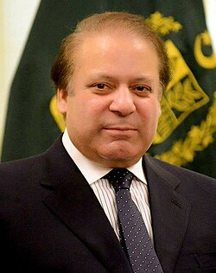
13TH AMENDMENT: DEFUSING 58-2B
Restoring Parliamentary Sovereignty
Passed on April 3, 1997, after Prime Minister Nawaz Sharif secured a decisive two-thirds majority in general elections.
•
Stripping Powers: Eliminated the President's discretionary power to dissolve the National Assembly under 58(2)(b).
•
Executive Realignment: Restored the Prime Minister as the supreme, unchallengeable head of the government.
•
Democratic Relief: Widely celebrated for defusing the executive "sword of Damocles" over the legislature.

Slide 17
14TH AMENDMENT: ANTI-DEFECTION
Targeting Floor Crossing: Passed on July 3, 1997, to eliminate the culture of shifting loyalties for financial and political gain.
Power to Party Heads: Granted political party leaders the authority to disqualify lawmakers who voted against the party line.
Stable Coalitions: Successfully ended the practice of engineering political shifts through floor-crossing.
Intra-Party Debate: Criticized for centralizing party control, limiting the freedom of speech of individual members of parliament.

Slide 18
PART IV: THE MILITARY REGIME
The Coup of 1999, Pervez Musharraf's Administration, and the Seventeenth Amendment (1999–2008)

Slide 19
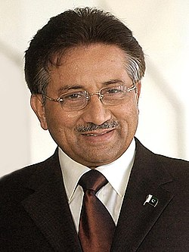
17TH AMENDMENT: ZIA REVIVED
Validating Military Supremacy
Enacted on December 31, 2003, this amendment consolidated the Legal Framework Order (LFO) issued by Pervez Musharraf.
•
Resurrecting 58(2)(b): Re-empowered the President to dissolve the National Assembly unilaterally.
•
Indemnity for Coup: Provided judicial and legislative validation to the 1999 military takeover.
•
Presidency Confirmed: Legalized Musharraf's status as President, bypassing standard parliamentary procedures.

Slide 20
PART V: PARLIAMENT RESTORED
The Eighteenth Amendment, Provincial Autonomy, and Historic Power Devolution (2010s)

Slide 21
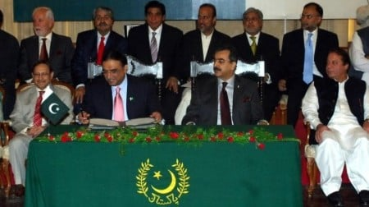
18TH AMENDMENT: HISTORIC DEVOLUTION
Restructuring the Federation
Passed unanimously on April 19, 2010, the 18th Amendment is considered the most comprehensive reform in Pakistan's constitutional history.
•
Definitive Repeal of 58(2)(b): Permanently removed the President's power to dissolve parliament.
•
Provincial Autonomy: Devolved massive administrative powers directly to the federating units.
•
Cultural Identity: Renamed North-West Frontier Province (NWFP) to Khyber Pakhtunkhwa (KP).

Slide 22
18TH AMENDMENT: POWER SHIFT
Concurrent List Abolished
NFC Award Protection
Devolved seventeen federal ministries, including Education and Health, directly to provincial cabinets, redefining the nature of Pakistani federalism.
Stipulated that the financial share of the provinces in subsequent National Finance Commission (NFC) awards can never drop below the previous share.

Slide 23






19TH & 20TH AMENDMENTS
Judicial Nominations
Caretaker Cabinets
ECP Autonomy
Both amendments strengthened democratic institutions, adding credibility to electoral systems and transfer of power.
The 19th Amendment (2011) restructured the Judicial Commission of Pakistan (JCP), adjusting the appointment system for superior judges.
The 20th Amendment (2012) refined the legal process for establishing neutral caretaker governments to supervise general elections.

Slide 24
21ST & 23RD: MILITARY COURTS
APS Massacre Backlash: Passed following the tragic terrorist attack on the Army Public School in Peshawar in December 2014.
Speedy Military Trials: Authorized the establishment of special military tribunals to conduct rapid trials of active terrorists.
21st Amendment (2015): Established a strict two-year sunset clause to prevent the courts from becoming permanent.
23rd Amendment (2017): Extended the authorization of these military courts for another two-year period following subsequent regional security challenges.

Slide 25
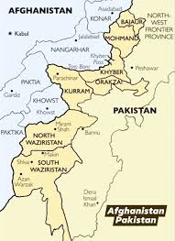
25TH AMENDMENT: FATA MERGER
Mainstreaming the Frontier Belt
Enacted on May 31, 2018, bringing a formal conclusion to the decades-long administrative isolation of the Federally Administered Tribal Areas.
•
FATA Merged to KP: Integrated the seven tribal agencies directly into the Khyber Pakhtunkhwa province.
•
Civil Liberties Extended: Abolished the colonial-era Frontier Crimes Regulation (FCR) in favor of standard civil rights.
•
Democratic Seats: Provided tribal citizens with direct representation in provincial and federal assemblies.

Slide 26
PART VI: CONTEMPORARY REFORMS
Judicial Restructuring, Institutional Transparency, and the Passing of the Twenty-Sixth Amendment (2020s)

Slide 27

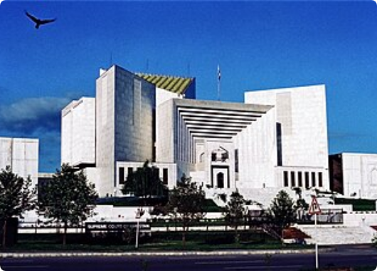
26TH AMENDMENT: COURT REFORMS
The Judicial Overhaul
Passed on October 21, 2024, under Shehbaz Sharif's administration. It targeted procedural delays in the superior judiciary.
•
CJP Term Limit: Fixed the tenure of the Chief Justice of Pakistan (CJP) at a strict maximum of three years.
•
Parliamentary Nominations: Tasked a special parliamentary committee to select the CJP from the 3 senior-most judges.
•
Ending Automatic Seniority: Replaced the automatic elevation of the senior-most judge with legislative selection.

Slide 28






26TH AMENDMENT: HIGHLIGHTS
Constitutional Benches
Environmental Rights
Islamic Economy
Set a constitutional deadline to eliminate Riba (usury/interest) from the financial machinery of Pakistan by January 1, 2028.
Established dedicated Constitutional Benches inside the Supreme Court and High Courts to exclusively handle basic rights disputes.
Introduced Article 9A, establishing a clean, healthy, and sustainable environment as a core fundamental right of citizens.

Slide 29

TIMELINE OF ARTICLE 58(2)(B)
Amendment | Year Enacted | Status of Presidential Power | System Style
Original 1973 Text | 1973 | No unilateral power; President bound by prime ministerial counsel. | Strict Parliamentary
Eighth Amendment | 1985 | Acquired unilateral authority to dissolve National Assembly at will. | Semi-Presidential
Thirteenth Amendment | 1997 | Power revoked; re-established parliamentary supremacy. | Strict Parliamentary
Seventeenth Amendment | 2003 | Power restored under military Legal Framework Order. | Semi-Presidential
Eighteenth Amendment | 2010 | Power permanently removed. Provincial autonomy restored. | Absolute Parliamentary

Slide 30
QUESTIONS & DISCUSSION

